Slide 1


ESTAC Troyes: Club Analysis
Data as at 16/09/2022
Ed Morris

Slide 2
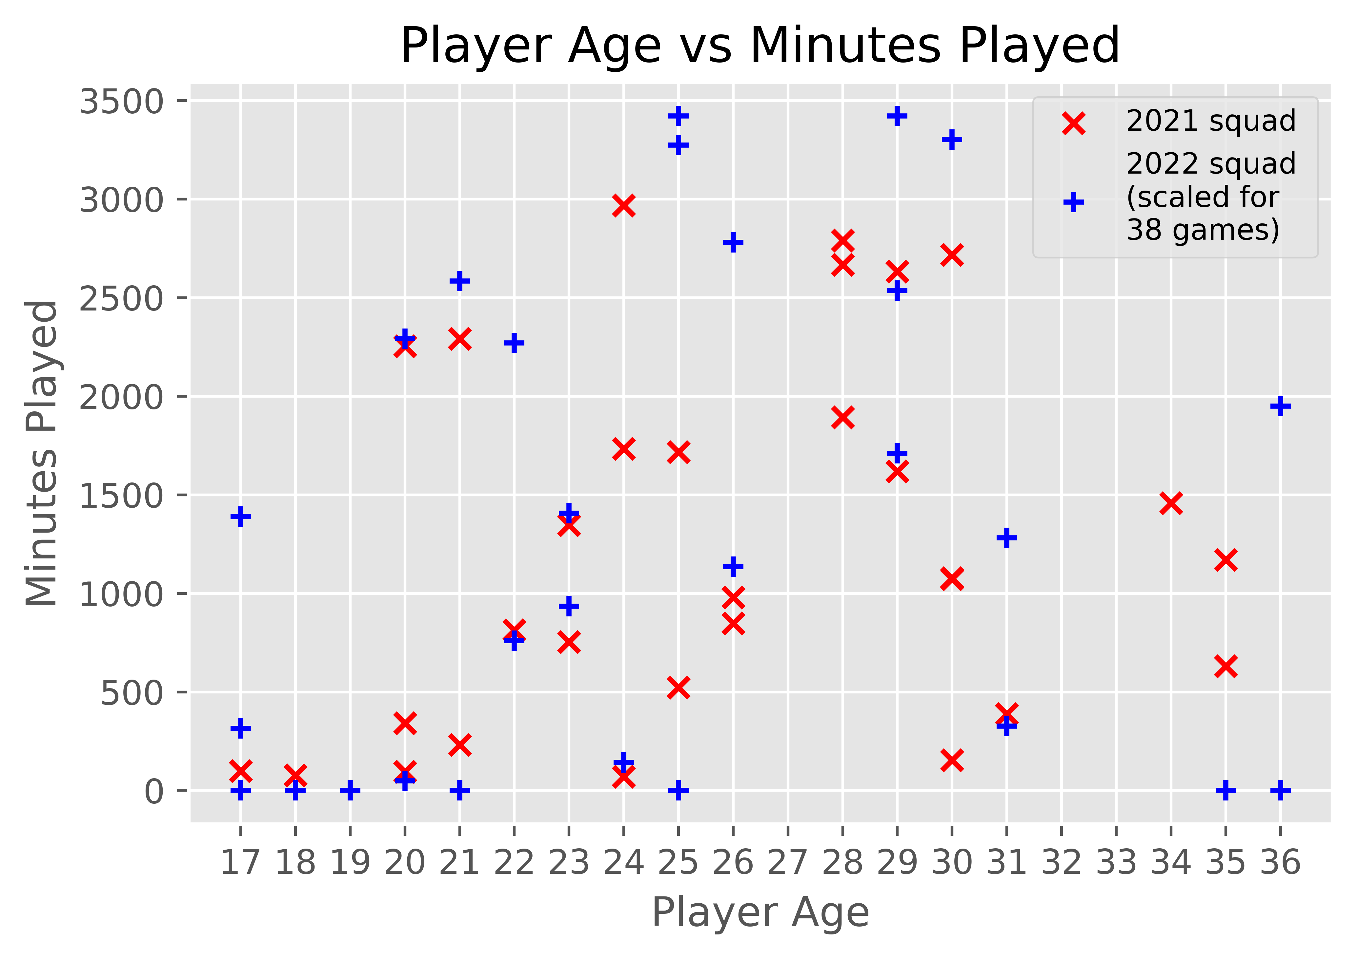
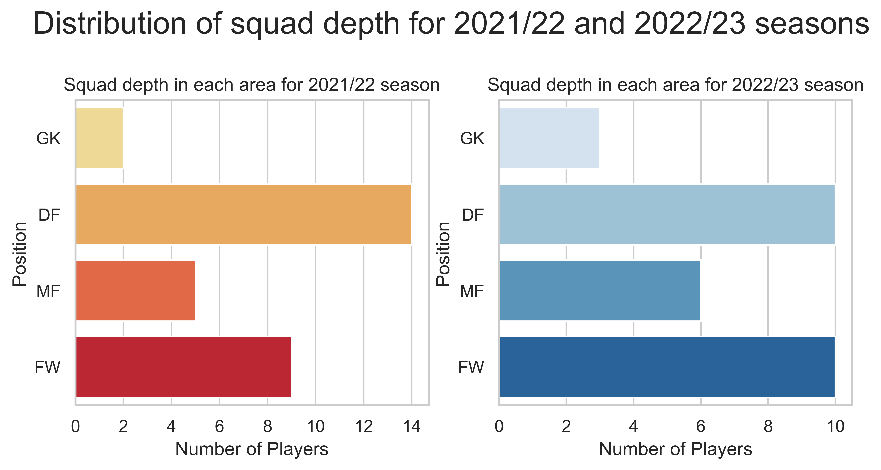
Current Season: Successes
Attacking performance
Squad age
Squad rebalancing
Current xG/shot = 0.11, up 10% on last season, quality of shooting opportunities has improved
Averaging 13.1 shots/game, up 28% on last season, number of shooting opportunities has improved
Projecting this to the end of the season gives xG of 54.8, compared to xG of 38.8 across last season which is a huge improvement
Maintained a similarly high proportion of shots being taken between the 6-yard box and the penalty spot (high xG areas), as seen in the histograms on left and right of the graphic
Strong improvements made to quality of shots produced and frequency of these shots compared to last season
Expecting a roughly similar distribution of player ages vs minutes played across the current season when scaled up compared to last year’s squad
Minute-Weighted-Average-Age (MWAA) decreased from 26.7 in 2021/22 to 25.9 for the 2022/23 squad
Fewer minutes played for players over the age of 30 in 2022/23 squad
Relying more on performance/development of younger talent, ensuring a sustainable/profitable approach taken
A successful example of this is approach from last season is Giulian Biancone (22), bought for £2.25m and sold to Nottingham Forest for 4x this price (£9m) one year later after a solid breakout season in Ligue 1
Summer transfer arrivals (permanent) have an average age of 20.8, further demonstrating this approach
Reduced the average age of the squad, increasing potential future profitability/sustainability of the squad if younger players perform well this season
Rebalanced the squad compared to last season
Added a much needed third GK for squad depth (providing cover for injuries and rotation for cup competitions)
Reduced the number of defenders (14 was excessive, even when utilising a 5-man defence in their frequently used 5-4-1/3-4-3)
Swapped out 4 DFs for a GK, MF and FW, creating more depth across the pitch for the team’s favoured 5-4-1/3-4-3
Some of the FWs are versatile and can be played as attacking MFs, meaning the large number of FWs can be utilised in a 5-4-1/3-4-3
Redistribution of squad depth across the positions was a natural progression which was required to provide appropriate cover for each area of the team

Slide 3
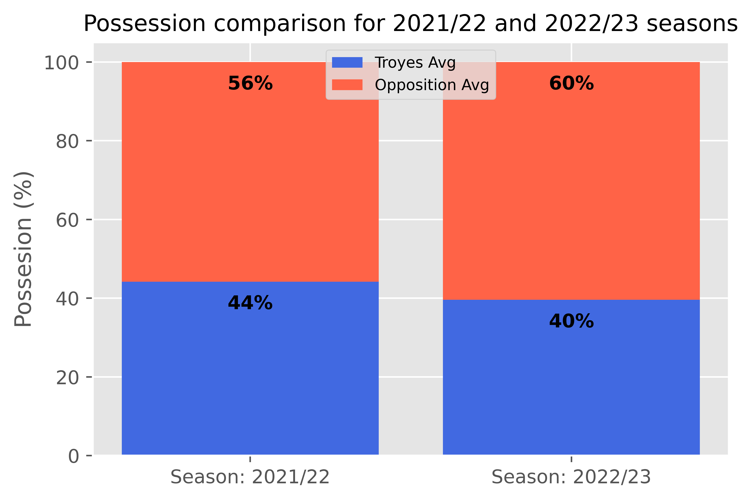
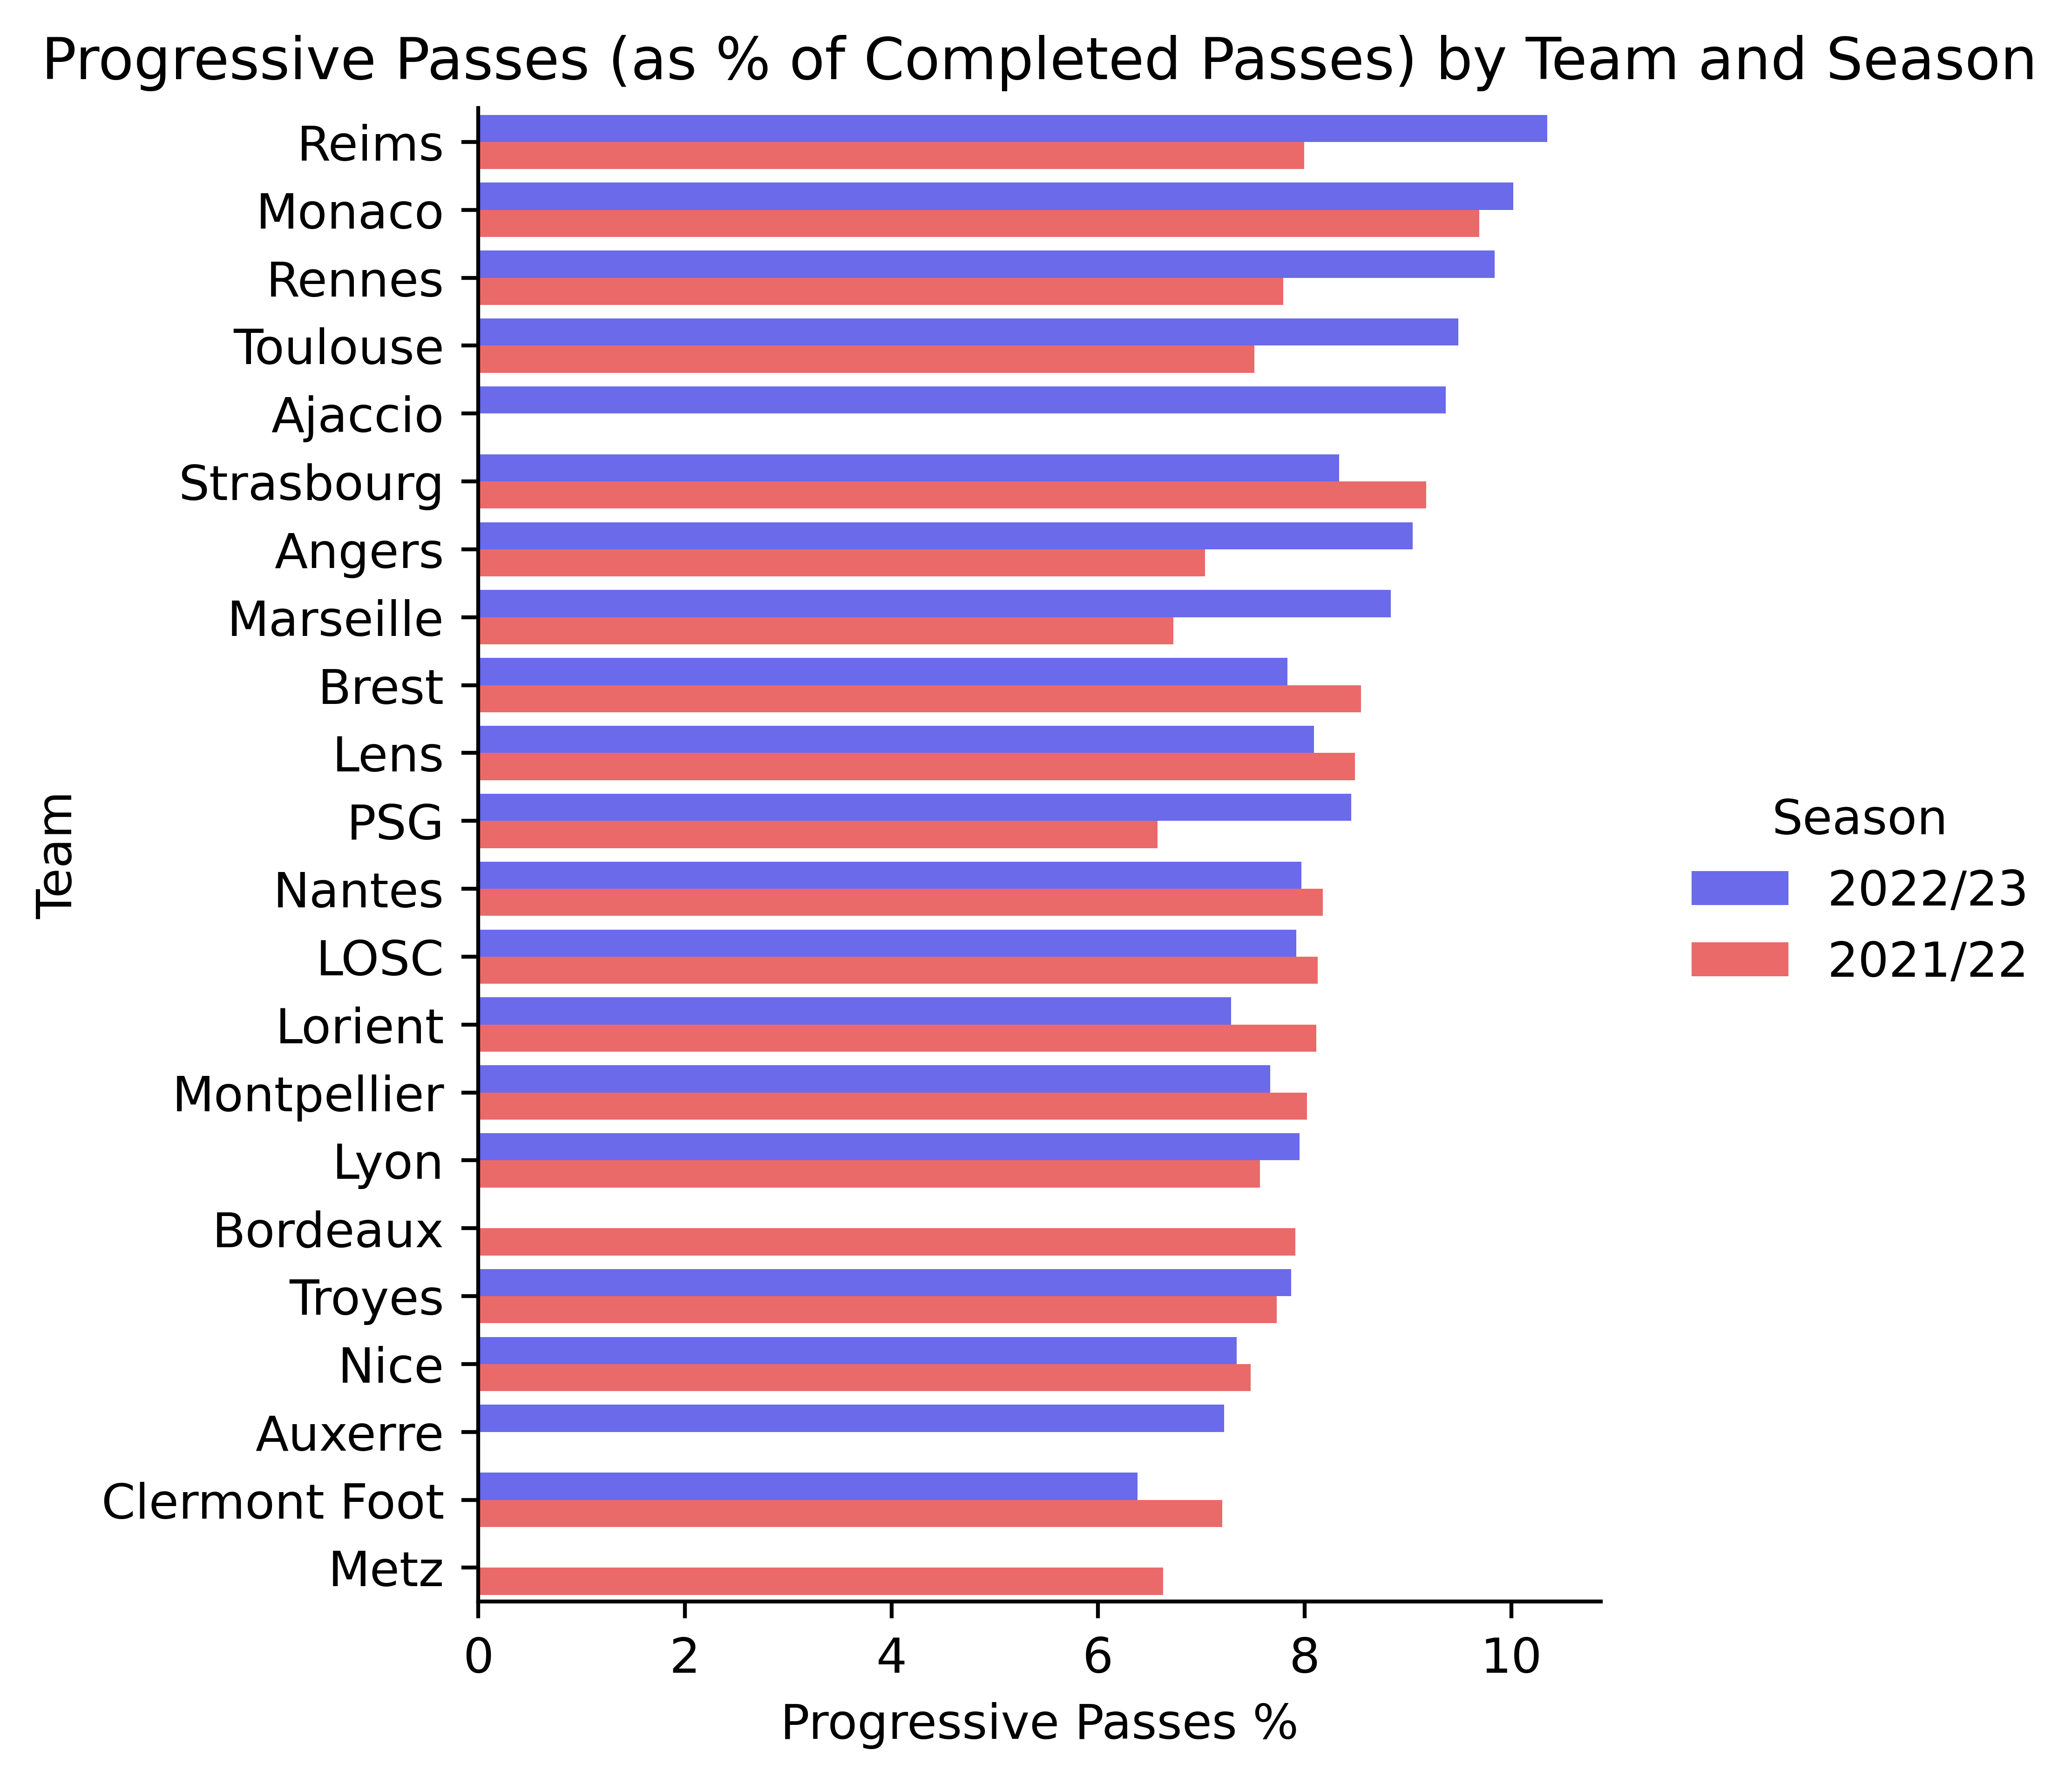
Current Season: Areas for Improvement
Defensive performance
Off-ball performance
Progressive passing performance
Current xG/shot against = 0.16, up 45% on last season
Averaging 12.7 shots/game against, up 4% on last season
Projection across the season gives xGA of 77.2, compared to 51.0 across last season
Projected xGD for the season of -22.4, worse than previous season’s actual performance (-16), potentially pushing them into the relegation fight
Improved attacking performance is cancelled out by the worsening defensive performances
Conceding more shots closer to goal this season (seen in top-skew of left histogram)
Conceding higher quality shots on average than last season with a slightly increased frequency, therefore likely to concede more goals
Pressures per 90 have dropped by 20.7% compared to last season, from 156.5 to 124.1
This is emphasised by a decrease in average possession per 90, dropping by 9.1% from 44% to 40%
We would expect a decrease in possession to lead to an increase in pressures if the same intensity is maintained
Pressures are a key part of defending across the whole pitch in the modern game; a decrease in pressures per 90 gives opposition players more time to make better decisions and create better chances, as seen in the defensive performance analysis
On the other hand, this could be due to a tactical change such as moving from a gegenpress/mid-block to a mid-block/low-block, i.e. applying pressure to the opposition closer towards their own goal
Reduction in number of pressures per 90 shows either a drop in intensity out of possession to win the ball back, or a tactical change
Were 11th in Ligue 1 for highest percentage of progressive passes played last season
Down to 13th in Ligue 1 this season
Teams with less possession typically play with a higher percentage of progressive passes in order to utilise possession when they have it (e.g. via counter-attacks)
Average possession has decreased this season, so would expect percentage of progressive passes to at least remain the same or increase
Progressive pass percentage improved slightly compared to last year in absolute terms, but has fallen against the league average this season

Slide 4
Data sources
Shot data:
https://understat.com/team/Troyes/2022
Squad statistics, pass and possession data:
https://fbref.com/en/squads/54195385/Troyes-Stats
Transfer data:
https://www.transfermarkt.co.uk/estac-troyes/transfers/verein/1095/plus/?saison_id=2022&pos=&detailpos=&w_s=s
Glossary
xG:
Expected Goals
xGA:
Expected Goals Against
xGD:
Expected Goal Difference
MWAA:
Minute-Weighted-Average-Age; calculates the average age of the squad giving more credit to players’ ages who have played more minutes

